Slide 1
Unit 6
Quality management
ISO and SEI CMMI
PSP and six sigma
Computer aided software engineering
Software maintenance
Software reuse
Component based software development

Slide 2
Advance techniques of software engineering
Agile development methodology
Scrum
Aspect oriented programming
Extreme Programming
Adaptive software development
Rapid application development (RAD)
Software coloning

Slide 3
Introduction
Traditional definition of quality:
  fitness of purpose,
    a quality product does exactly what the users want it to do.

Slide 4
Fitness of purpose
For software products,
  fitness of purpose:
    satisfaction of the requirements specified in SRS document.

Slide 5
Introduction
Consider a software product:
  functionally correct,
    i.e. performs all functions as specified in the SRS document,
  but has an almost unusable user interface.
    cannot be considered as a quality product.

Slide 6
Introduction
Another example:
  a product which does everything that users want.
  but has an almost incomprehensible and unmaintainable code.

Slide 7
Question
What are basic parameters of quality product?
Functions should be based on SRS
User friendly user interface
Proper Documentation
All of above

Slide 8
Modern view of quality
Associates several quality factors with a software product :
  Correctness
  Portability
  Usability
  Reusability
  Maintainability
  Others parameters are: reliability, efficiency etc and many more as per McCall’s quality factors

Slide 9
McCall’s Software Quality Model
McCall’s Software Quality Model was introduced in 1977. This model is incorporated with many attributes, termed software factors, which influence software.
This model classifies all software requirements into 11 software quality factors.
The 11 factors are organized into three product quality factors: Product Operation, Product Revision, and Product Transition.

Slide 10
MCCall’s Model
-- Product operation factors: Correctness, reliability, efficiency, Integrity, Usability
-- Product revision factors: maintainability, flexibility, testability
-- Product transition factors: portability, reusability, interoperability

Slide 11
Product Operation
It includes five software quality factors, which are related to the requirements that directly affect the operation of the software.
Correctness: The extent to which software meets its requirements specification.
Efficiency: The number of hardware resources and code the software, needs to perform a function.
Integrity: The extent to which the software can control an unauthorized person from accessing the data or software.
Reliability: The extent to which software performs its intended functions without failure.
Usability: The extent of effort required to learn, operate, and understand the functions of the software.

Slide 12
Product Revision
It includes three software quality factors, which are required for testing and maintenance of the software.
Maintainability: The effort required to detect and correct an error during maintenance.
Flexibility: The effort needed to improve an operational software program.
Testability: The effort required to verify software to ensure that it meets the specified requirements.

Slide 13
Product Transition
It includes three software quality factors, that allow the software to adapt to the change of environments in the new platform or technology from the previous.
Portability: The effort required to transfer a program from one platform to another.
Re-usability: The extent to which the program’s code can be reused in other applications.
Interoperability: The effort required to integrate two systems.

Slide 14
1. Which of the following is not one of three software product aspects addressed by McCall’s software quality factors? [UGC-NET 2017]
(A) Ability to undergo change
(B) Adaptability to new environments
(C) Operational characteristics
(D) Production costs and scheduling
Solution: Correct answer is (D).

Slide 15
2. Which one is not a product quality factor of McCall’s quality model?
(A) Product Revision
(B) Product Operation
(C) Product Specification
(D) Product Transition
Solution: Correct Answer is (C).

Slide 16
Software Quality Management System
Quality management system (or quality system):
  principal methodology used by organizations to ensure that the products have desired quality.

Slide 17
Quality system
Every quality conscious organization has an independent quality department:
  performs several quality system activities.
  needs support of top management.
  Without support at a high level in a company,
    many employees may not take the quality system seriously.

Slide 18
Quality System Activities:
Auditing of projects
Development of:
  standards, procedures, and guidelines, etc.
Production of reports for the top management
  summarizing the effectiveness of the quality system in the organization.
Review of the quality system itself.

Slide 19
Quality system
A good quality system must be well documented.
  Without a properly documented quality system,
    application of quality procedures become ad hoc,
    results in large variations in the quality of the products delivered.

Slide 20
Quality system
An undocumented quality system:
  sends clear messages to the staff about the attitude of the organization towards quality assurance.
International standards such as ISO 9000 provide:
  guidance on how to organize a quality system.

Slide 21
Quality Assurance
Quality Assurance is defined as an activity that ensures the approaches, techniques, methods, and processes designed for the projects are implemented correctly.
It recognizes defects in the process. Quality Assurance is completed before Quality Control.
It focuses on preventing defects.
It is a proactive process and is preventive in nature.
It helps to recognize flaws in the process.
These activities monitor and verify that the processes used to manage and create deliverables have been followed.

Slide 22
Quality Control
Quality Control is a software engineering process that is used to ensure that the approaches, techniques, methods, and processes designed for the project are followed correctly.
Quality control activities operate and verify that the application meet the defined quality standards.
It focuses on an examination of the quality of the end products and the final outcome rather than focusing on the processes used to create a product.
It is a reactive process and is detection in nature.
These activities monitor and verify that the project deliverables meet the defined quality standards.

Slide 23
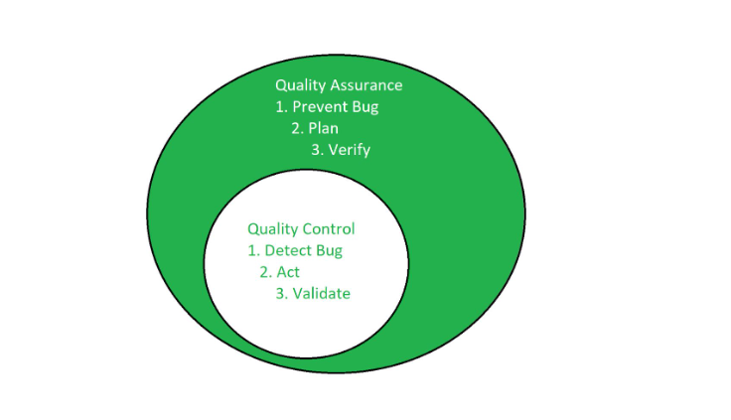

Slide 24
Total quality management (TQM)
Advocates:
  continuous process improvements through process measurements.

Slide 25
Business Process reengineering
A term related to TQM.
Process reengineering goes a step further than quality assurance:
  aims at continuous process improvement.

Slide 26
Business Process reengineering
Our focus is reengineering of the software process.
Whereas BPR aims at reengineering the way business is carried out in any organization
  not just software development organizations.

Slide 27
Total quality management (TQM)
TQM goes beyond documenting processes
  optimizes them through redesign.
Over the years the quality paradigm has shifted:
  from product assurance to process assurance.

Slide 28
Question
In which stage of the quality system the reengineering process in involved?
Quality assurance
Quality control
Total quality management
Inspection

Slide 29
ISO 9000:
It is a set of International Standards on quality management and quality assurance developed to help companies effectively document the quality system elements needed to an efficient quality system.
SEICMM:
SEI (Software Engineering Institute), Capability Maturity Model (CMM) specifies an increasing series of levels of a software development organization.

Slide 30
ISO 9000
ISO (International Organization for Standardization):
  a consortium of 63 countries established to formulate and foster standardization.
ISO published its 9000 series of standards in 1987.

Slide 31
What is ISO 9000 Certification?
ISO 9000 certification:
  serves as a reference for contract between independent parties.
The ISO 9000 standard:
  specifies guidelines for maintaining a quality system.

Slide 32
What is ISO 9000 Certification?
ISO 9000 specifies:
  guidelines for repeatable and high quality product development.
  Also addresses organizational aspects
    responsibilities, reporting, procedures, processes, and resources for implementing quality management.

Slide 33
ISO 9000
A set of guidelines for the production process.
  not directly concerned about the product it self.
  a series of three standards:
    ISO 9001, ISO 9002, and ISO 9003.

Slide 34
ISO 9000
Based on the premise:
  if a proper process is followed for production:
    good quality products are bound to follow.

Slide 35
ISO 9001:
Applies to:
  organizations engaged in design, development, production, and servicing of goods.
  applicable to most software development organizations.

Slide 36
ISO 9002:
ISO 9002 applies to:
  organizations who do not design products:
    but are only involved in production.
Examples of this category of industries:
  steel or car manufacturing industries
  buy the product and plant designs from external sources:
    only manufacture products.
  not applicable to software development organizations.

Slide 37
ISO 9003
ISO 9003 applies to:
  organizations involved only in installation and testing of the products.

Slide 38
ISO 9000 for Software Industry
ISO 9000 is a generic standard:
  applicable to many industries,
    starting from a steel manufacturing industry to a service rendering company.
Many clauses of ISO 9000 documents:
  use generic terminologies
  very difficult to interpret them in the context of software organizations.

Slide 39
ISO 9000 Part-3
ISO released a separate document called ISO 9000 part-3 in 1991
  to help interpret the ISO standard for software industry.
At present,
  official guidance is inadequate

Slide 40
Why Get ISO 9000 Certification?
Several benefits:
  Confidence of customers in an organization increases
    if organization qualified for ISO 9001 certification.
    This is especially true in the international market.

Slide 41
Why Get ISO 9000 Certification?
Many international software development contracts insist:
  development organization to have ISO 9000 certification.

Slide 42
Why Get ISO 9000 Certification?
Requires:
  a well-documented software production process to be in place.
  contributes to repeatable and higher quality software.
Makes development process:
  focussed, efficient, and cost-effective

Slide 43
Why Get ISO 9000 Certification?
Points out the weakness of an organizations:
  recommends remedial action.
Sets the basic framework:
  for development of an optimal process and TQM.

Slide 44
How to Get ISO 9000 Certification?
An organization intending to obtain ISO 9000 certification:
  applies to a ISO 9000 registrar for registration.
ISO 9000 registration process consists of several stages.

Slide 45
How to Get ISO 9000 Certification?
Application stage:
  Applies to a registrar for registration.
Pre-assessment:
  the registrar makes a rough assessment of the organization.

Slide 46
How to Get ISO 9000 Certification?
Document review and adequacy audit:
  process and quality-related documents.
  the registrar reviews the documents
  makes suggestions for improvements.

Slide 47
How to Get ISO 9000 Certification?
Compliance audit: the registrar checks
  whether the suggestions made by it during review have been complied.

Slide 48
How to Get ISO 9000 Certification?
Registration:
  The registrar awards ISO 9000 certificate after successful completions of all previous phases.
Continued surveillance:
  The registrar continues monitoring the organization periodically.

Slide 49
ISO 9000 Certification
An ISO certified organization
  can use the certificate for corporate advertizements
  cannot use the certificate to advertize products.
    ISO 9000 certifies organization's process
    not any product of the organization.
  An organization using ISO certificate for product advertizements:
    risks withdrawal of the certificate.

Slide 50
Salient features of ISO 9001 requirements:
All documents concerned with the development of a software product
  should be properly managed, authorized, and controlled.
Proper plans should be prepared
  progress against these plans should be monitored.

Slide 51
Salient features of ISO 9001 requirements:
Important documents independently checked and reviewed:
  for effectiveness and correctness.
The product should be tested :
  against specification.
Several organizational aspects:
  e.g., management reporting of the quality team.

Slide 52
Shortcomings of ISO 9001 Certification (1)
ISO 9000 requires a production process to be adhered to:
  but does not guarantee the process to be of high quality.
  Does not give any guideline for defining an appropriate process.

Slide 53
Shortcomings of ISO 9001 Certification (6)
ISO 9001 addresses mostly management aspects.
Techniques specific to software development have been ignored
  Configuration management
  Reviews
  Release builds
  Problem Notification system

Slide 54
SEI Capability Maturity Model
Developed by Software Engineering Institute (SEI) of the Carnegie Mellon University, USA:
  to assist the U.S. Department of Defense (DoD) in software acquisition.
  The rationale was to include:
    likely contractor performance as a factor in contract awards.

Slide 55
SEI Capability Maturity Model
Major DoD contractors began CMM-based process improvement initiatives:
  as they vied for DoD contracts.
SEI CMM helped organizations:
  Improve quality of software they developed
  Realize adoption of SEI CMM model had significant business benefits.
Other organizations adopted CMM.

Slide 56
SEI Capability Maturity Model
In simple words,
  CMM is a model for apprising the software process maturity of a contractor into different levels.
  Can be used to predict the most likely outcome to be expected from the next project that the organization undertakes.

Slide 57
SEI Capability Maturity Model
Can be used in two ways:
  Capability evaluation
  Software process assessment.

Slide 58
Capability Evaluation
Provides a way to assess the software process capability of an organization
  Helps in selecting a contractor
  Indicates the likely contractor performance

Slide 59
Software Process Assessment
Used by an organization to assess its current process:
  Suggests ways to improve the process capability.
  This type of assessment is for purely internal use.

Slide 60
SEI Capability Maturity Model
The SEI CMM classifies software development industries into:
  Five maturity levels.
  Stages are ordered so that improvements at one stage provide foundations for the next
  Based on the pioneering work of Philip Crosby

Slide 61
SEI Capability Maturity Model
Optimizing (5)
Managed (4)
Defined (3)
Repeatable (2)
Initial (1)

Slide 62
Level 1: (Initial)
Organization operates
  without any formalized process or project plans
An organization at this level is characterized by
  ad hoc and often chaotic activities.

Slide 63
Level 1: (Initial)
Software production processes are not defined,
  different engineers follow their own process
  development efforts become chaotic.
  The success of projects depend on individual efforts and heroics.

Slide 64
Level 2: (Repeatable)
Basic project management practices
  tracking cost, schedule, and functionality are followed.
Size and cost estimation techniques
  function point analysis, COCOMO, etc. used.
Production process is ad hoc
  not formally defined
  also not documented.

Slide 65
Level 3: (Defined)
Management and development activities:
  defined and documented.
  Common organization-wide understanding of activities, roles, and responsibilities.

Slide 66
Level 3: (Defined)
The process though defined,
  process and product qualities are not measured.
ISO 9001 aims at achieving this level.

Slide 67
Level 4: (Managed)
Quantitative quality goals for products are set.
Software process and product quality metrics are collected:

Slide 68
Level 4: (Managed)
Organization sets quantitative quality goals
World-wide about 100 organizations assessed at this level.

Slide 69
Level 5: (Optimizing)
Statistics collected from process and product measurements are analyzed:
  continuous process improvement based on the measurements.
    Known types of defects are prevented from recurring by tuning the process
    lessons learned from specific projects incorporated into the process

Slide 70
Level 5: (Optimizing)
Identify best software engineering practices and innovations:
  tools, methods, or process are identified
  transferred throughout the organization
World-wide about 50 organizations have been assessed at this level.

Slide 71
Key Process Areas
Each level is associated with a key process area (KPA) identifies
  where an organization at the previous level must focus to reach this level

Slide 72
Level 2 KPAs
Software project planning
  Size, cost, schedule.
  project monitoring
Configuration management
Subcontract management

Slide 73
Level 3 KPAs
Process definition and documentation
Reviews
Training program

Slide 74
Level 4 KPAs
Quantitative measurements
Process management

Slide 75
Level 5 KPAs
Defect prevention
Technology change management
Process change management

Slide 76
Shortcomings of CMM
Focuses on what needs to improve but does not guide about how to improve.
Thicker documentations and longer meetings are required
Getting an accurate measure of an organization’s current maturity level is also an issue

Slide 77
Comparison between ISO 9001 and SEI CMM
ISO 9001 awarded by an international standards body
  can be quoted in official documents and communications
SEI CMM assessment is purely for internal use.

Slide 78
Comparison between ISO 9001 and SEI CMM
SEI CMM was developed specifically for software industry:
  addresses many issues specific to software industry.
SEI goes beyond quality assurance
  aims for TQM
  ISO 9001 correspond to SEI level 3.

Slide 79
Comparison between ISO 9001 and SEI CMM
SEI CMM provides a list of key areas
  on which to focus to take an organization from one level to the other
Provides a way for gradual quality improvements over several stages.
  e.g trying to implement a defined process before a repeatable process:
    counterproductive as managers are overwhelmed by schedule and budget pressure.

Slide 80
CMMI
It is successor of CMM.
CMM developed from 1987-1997
In 2002, CMMI version 1.1 was released
CMMI aimed to improve the maturity models by integrating many different models into one framework
CMM versions are: SE-CMM, T-CMM, SSE-CMM, P-CMM, IPD-CMM etc.
CMMI integrated like: CMMI-SE/SW, CMMI-SE/SW/IPD etc.

Slide 81
Question
Q: At which level of SCI we are aiming to achieve ISO 9001 certification?
A: Level 2
B: Level 3
C: Level 4
D: Level 5

Slide 82
Personal Software Process (PSP)
Based on the work of Humphrey
PSP is a scaled down version of industrial software process
  suitable for individual use
Even CMM assumes that engineers use effective personal practices

Slide 83
Personal Software Process (PSP)
A process is the set of steps for doing a job
The quality and productivity of an engineer
  largely determined by his process
PSP is framework that
  helps software engineers to measure and improve the way they work.

Slide 84
Personal Software Process (PSP)
Helps developing personal skills and methods
  Estimating and planning method
  Shows how to track performance against plans
  Provides a defined process
    can be fine tuned by individuals
    Recognizes that a process for individual use is different from that necessary for a team project.

Slide 85
Personal Software Process (PSP)
Planning
Design
Code
Logs
Compile
Test
Project plan summary
Postmortem

Slide 86
PSP-Planning
Problem definition
Estimate max, min, and total LOC
Determine minutes/LOC
Calculate max,min, and total development times
Enter the plan data in project plan summary form
record the planned time in Log

Slide 87
PSP-Design
Design the program
Record the design in specified format
Record the Design time in time recording log

Slide 88
PSP-Code
Implement the design
Use a standard format for code text
Record the coding time in time recording log

Slide 89
PSP-Compile
Compile the program
Fix all the defects
Record compile time in time recording log

Slide 90
PSP-Test/Postmortem
Test
  Test the program
  Fix all the defects found
  Record testing time in time recording log
Postmortem
  Compare the log data with project plan to achieve better planning in future projects to improve his process.

Slide 91
Personal Software Process (PSP)
PSP 3
• Personal process
evolution
PSP 2
• Personal quality management
• Design and code reviews
PSP 1
•Personal planning
• Time and schedule
PSP 0
• Personal measurement
• Basic size measures

Slide 92
Extreme Programming
What is Extreme Programming?
XP is a lightweight, efficient, low-risk, flexible, predictable, scientific, and fun way to develop a software.
eXtreme Programming (XP) was conceived and developed to address the specific needs of software development by small teams in the face of vague and changing requirements.

Slide 93
Extreme Programming is one of the Agile software development methodologies. It provides values and principles to guide the team behavior. The team is expected to self-organize. Extreme Programming provides specific core practices where −
Each practice is simple and self-complete.
Combination of practices produces more complex and emergent behavior.

Slide 94
Extreme Programming in a Nutshell
Extreme Programming involves −
Writing unit tests before programming and keeping all of the tests running at all times. The unit tests are automated and eliminates defects early, thus reducing the costs.
Starting with a simple design just enough to code the features at hand and redesigning when required.
Programming in pairs (called pair programming), with two programmers at one screen, taking turns to use the keyboard. While one of them is at the keyboard, the other constantly reviews and provides inputs.
Integrating and testing the whole system several times a day.
Putting a minimal working system into the production quickly and upgrading it whenever required.
Keeping the customer involved all the time and obtaining constant feedback.

Slide 95
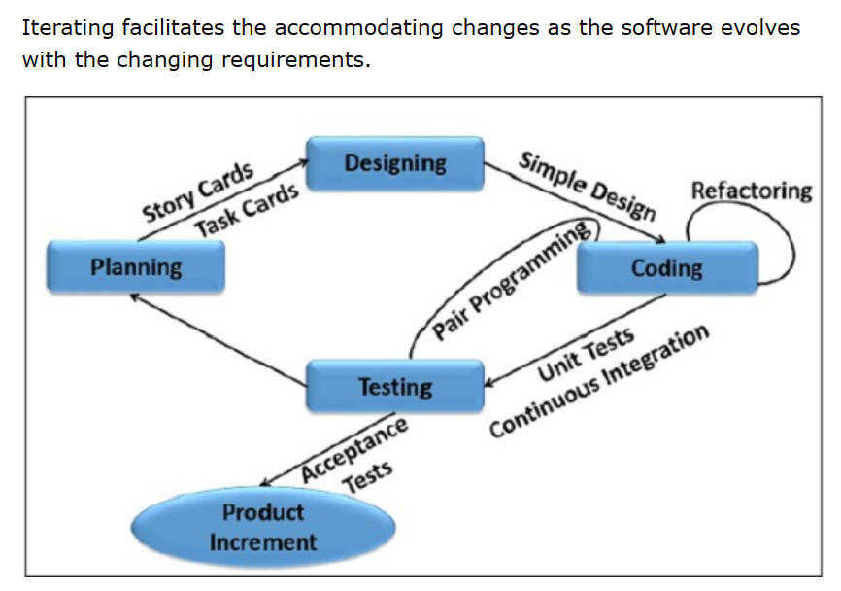

Slide 96
Why is it called “Extreme?”
Extreme Programming takes the effective principles and practices to extreme levels.
Code reviews are effective as the code is reviewed all the time.
Testing is effective as there is continuous regression and testing.
Design is effective as everybody needs to do refactoring daily.
Integration testing is important as integrate and test several times a day.
Short iterations are effective as the planning game for release planning and iteration planning.

Slide 97
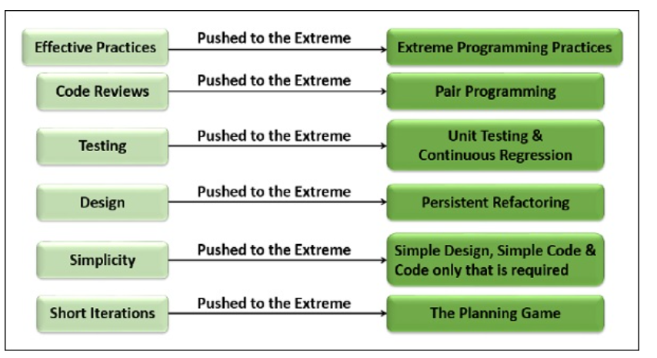

Slide 98
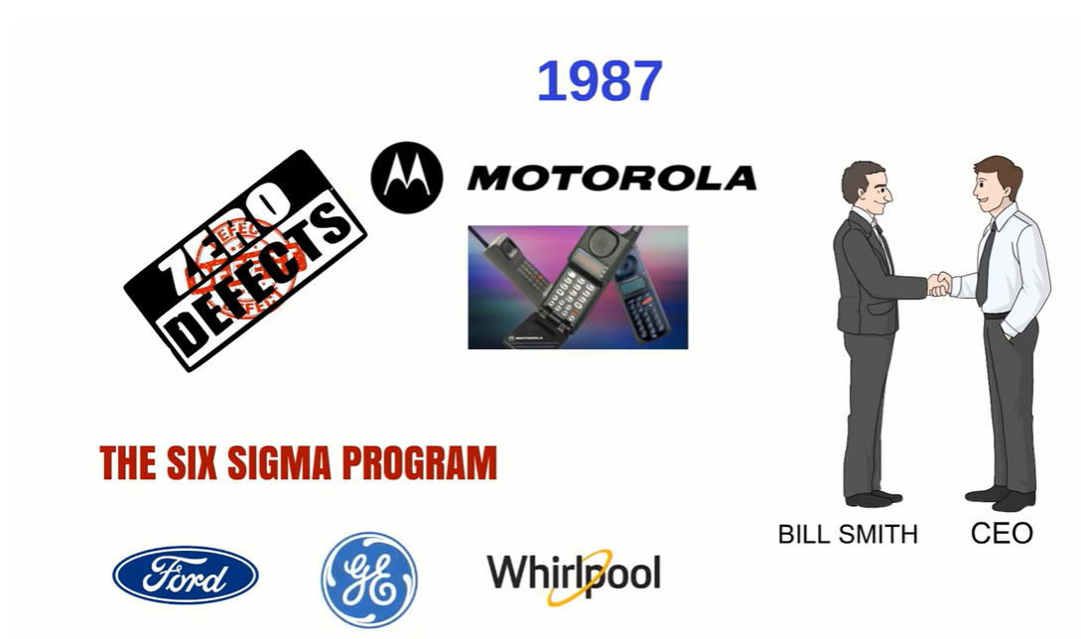
Six Sigma

Slide 99
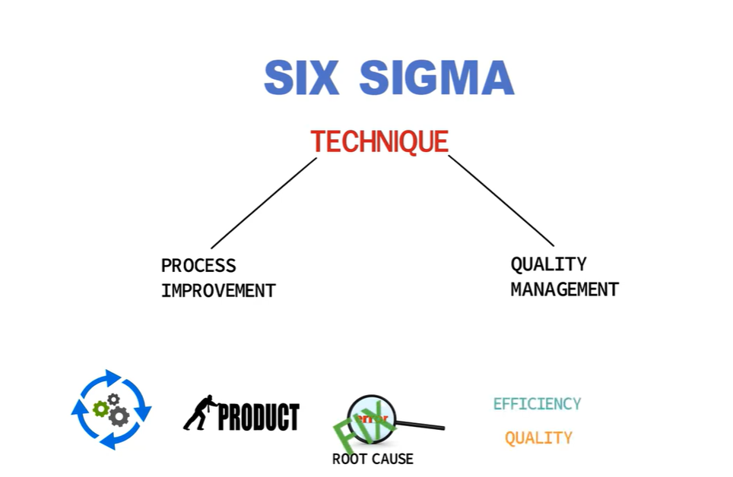

Slide 100
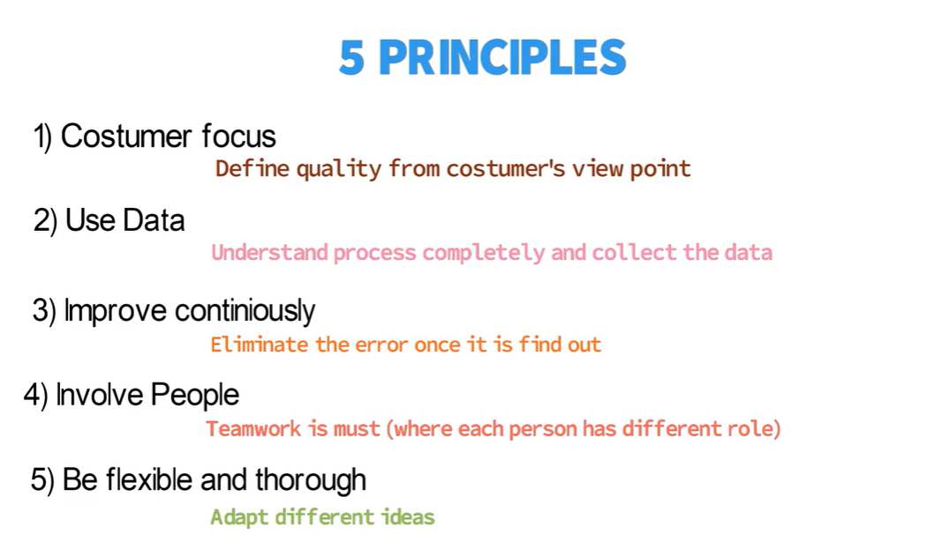

Slide 101
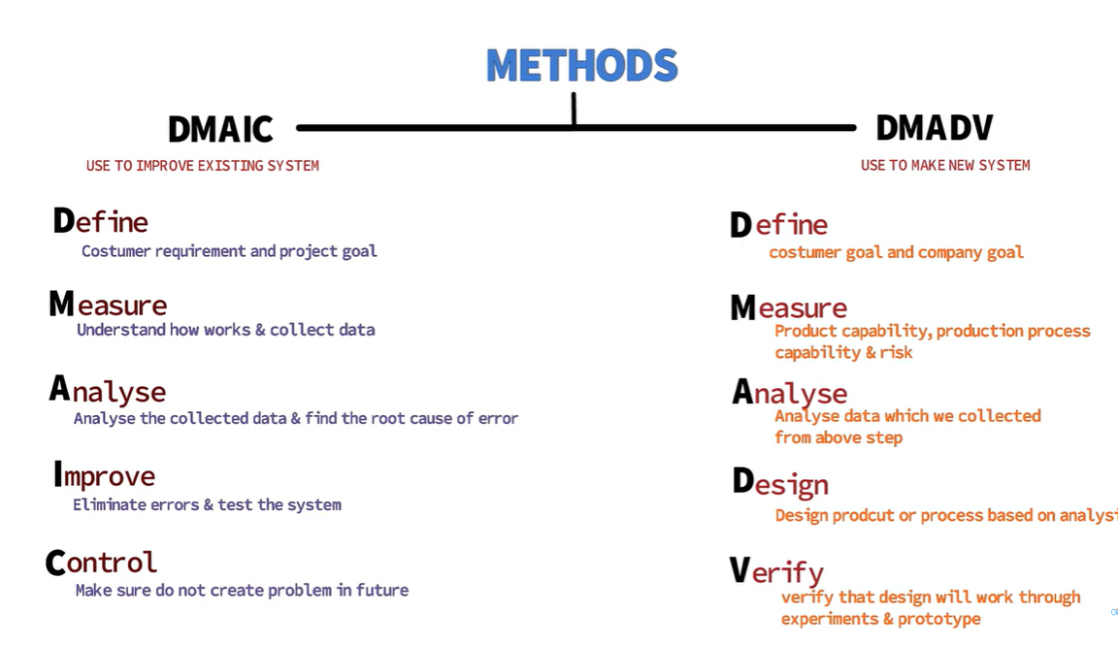

Slide 102
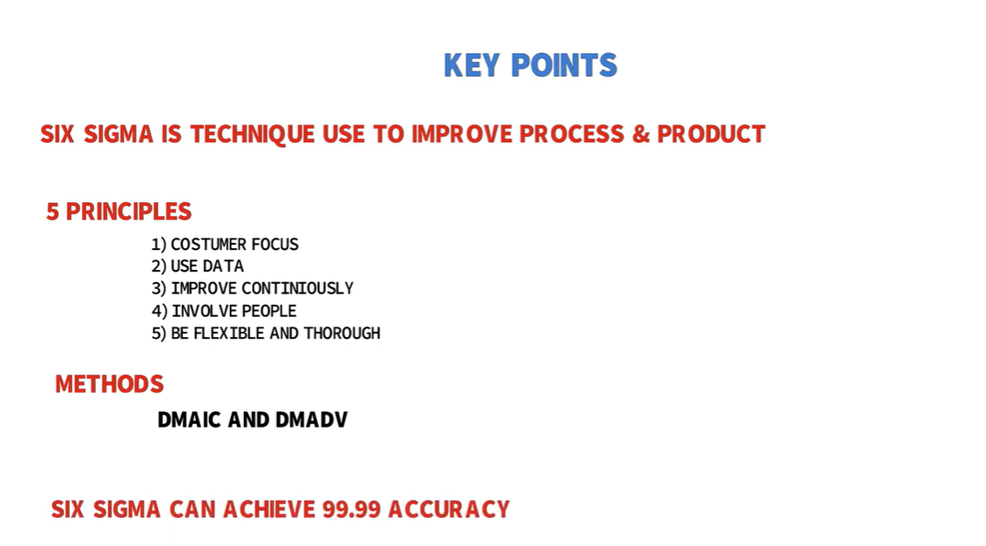

Slide 103
The belt levels in Six Sigma are similar to the belt rankings awarded in the martial arts. Belts are titles awarded to practitioners based on their level of skill, experience, knowledge and training in Six Sigma principles.

Slide 104


Slide 105
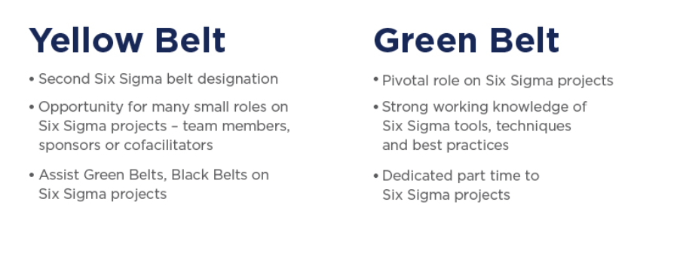

Slide 106
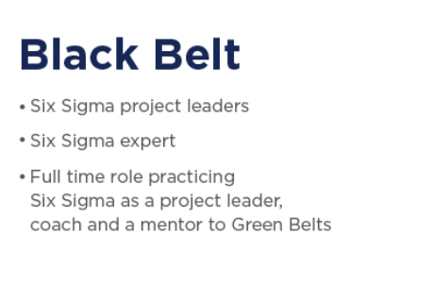

Slide 107
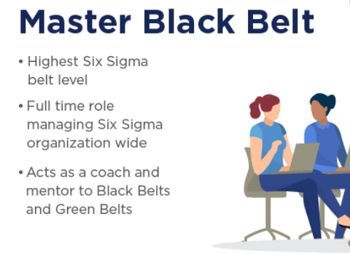

Slide 108
Six Sigma
Six sigma is a quantitative approach to eliminate defects
  Applicable to all types of industry - from manufacturing, product development, to service
The statistical representation of Six Sigma quantitatively describes
  how a process is performing

Slide 109
Six Sigma
To achieve six sigma
  a process must not produce more than 3.4 defects per million opportunities.
  5 Sigma -> 230 defects per million
  4 Sigma -> 6210 defects per million
Six sigma methodologies
  DMAIC (Define, Measure, Analyze, Improve, Control)
  DMADV: (Define, Measure, Analyze, Design, Verify)

Slide 110
Six Sigma Methodologies
The methodologies are implemented by Green belt and Black belt workers
  Supervised by Master black belt worker

Slide 111
Question
Which of the following person is responsible to supervise the implementation of six sigma in an organization?
A: Master black belt
B: Master green belt
C: Green belt
D: Black belt

Slide 112
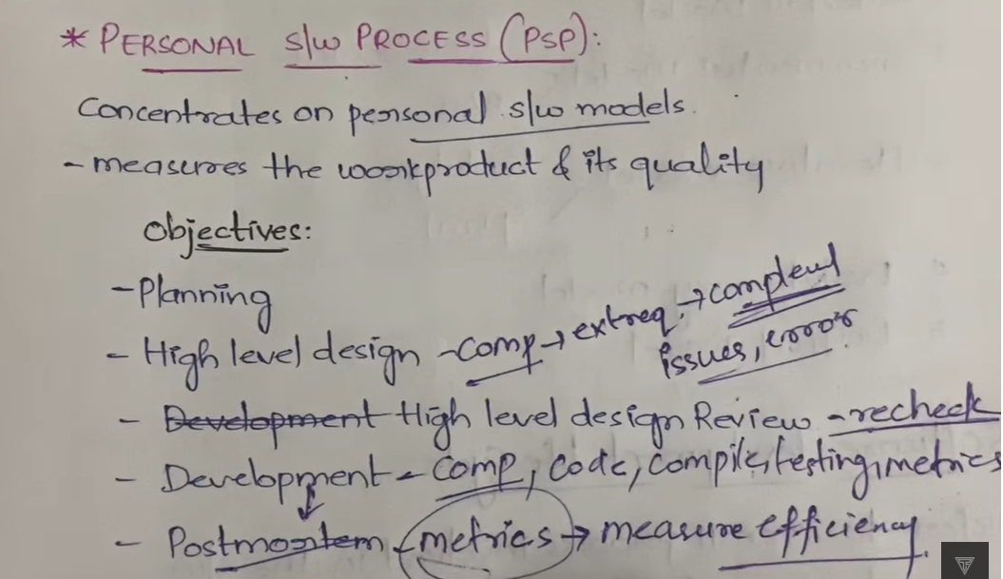
PSP

Slide 113
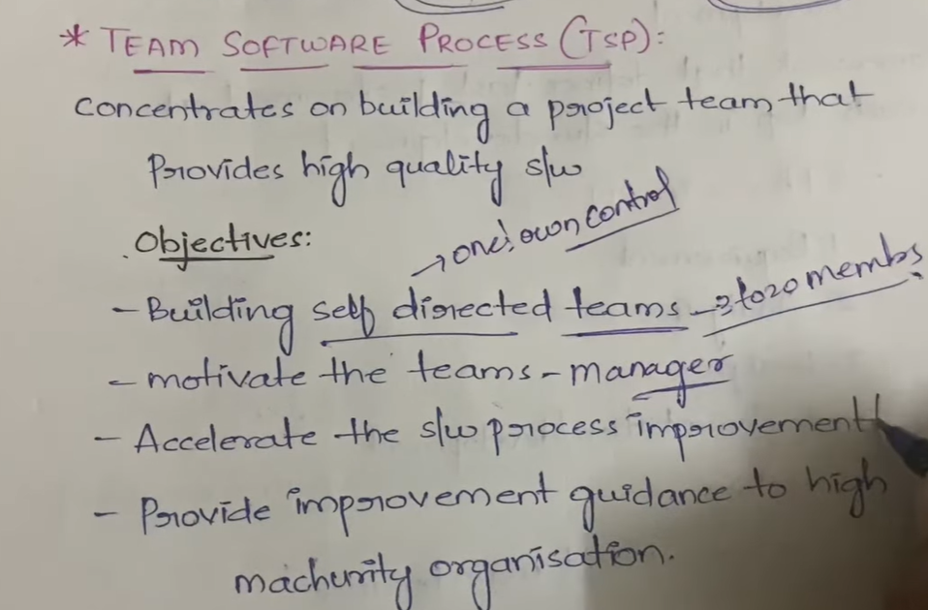

Slide 114
Cloning Software
Cloning software is a range of tools designed to make a complete copy of a hard drive to an image file. This copy can than be used to duplicate the contents of a hard drive to the same computer or to a new computer. The cloned disk is a bit-for-bit copy.

Slide 115
Cloning software is used to make a complete backup copy of a hard drive, where conventional backup software typically works on individual files. A bit-for-bit copy is made to an image file, which can then be copied back to the hard drive in case of failure.

Slide 116
There are several major uses for cloning software. Companies can load a standard image file with the operating system and applications and deploy it to all computers using a clone server. If the hard drive is being upgraded to a larger one, all the information can be copied to the image for restoration after the new drive is installed. A computer that is sold or given to a new users can be reloaded with an image without the previous user’s files.

Slide 117
Adaptive Software Development
ASD is a method to build complex software and system. ASD focuses on human collaboration and self-organization.
Adaptive software development (ASD) is a software development process that grew out of the work by Jim Highsmith and Sam Bayer on rapid application development (RAD).

Slide 118
ASD “life cycle” incorporates three phases namely:
1. Speculation
2. Collaboration
3. Learning

Slide 119
1. Speculation:
During this phase project is initiated and planning is conducted. The project plan uses project initiation information like project requirements, user needs, customer mission statement, etc, to define set of release cycles that the project wants.

Slide 120
2. Collaboration:
It is the difficult part of ASD as it needs the workers to be motivated. It collaborates communication and teamwork but emphasizes individualism as individual creativity plays a major role in creative thinking. People working together must trust each others to

Slide 121
Criticize without animosity,
Assist without resentment,
Work as hard as possible,
Possession of skill set,
Communicate problems to find effective solution.

Slide 122
3. Learning:
The workers may have a overestimate of their own understanding of the technology which may not lead to the desired result. Learning helps the workers to increase their level of understanding over the project.

Slide 123
Learning process is of 3 ways:
Focus groups
Technical reviews
Project postmortem

Slide 124
ASD’s overall emphasis on the dynamics of self-organizing teams, interpersonal collaboration, and individual and team learning yield software project teams that have a much higher likelihood of success

Slide 125
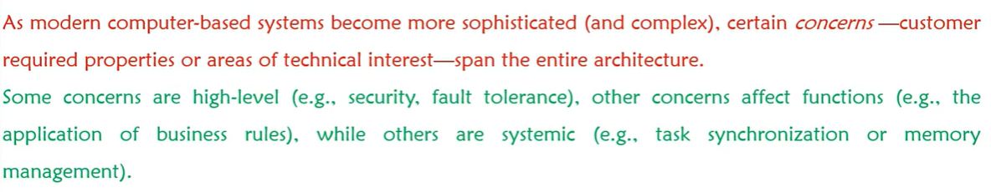
Aspect oriented

